Slide 1
STUDENT MENTORING APPLICATION
Prepared By
Chintan Patel (17it066)
Guided by
Mr.Mrudang Pandya

Slide 2
outline
Project Description
Functionality
Technology used
Screenshots
References

Slide 3
Project description
There are major three reason why we choose this project,
first is about students They are not aware about what and which professors study and work on which new technology and project. This is happened because of communication gap between student and mentor.
Second reason is about mentor, because of busy scheduling of college mentor sometimes cannot able to give time for his/her working batch.
last one reason is parents, they also want to know what is happening in collage and what is progress of their child.
In this application, there are three main entities students, parents and mentors. Functionalities of application are chat with all above entity as per group or head to head chat, student progress report, daily post related to what is happening in college campus on which technology and which topic, parents talk, etc.

Slide 4
Functionality
Data Validation
Encryption
Because of This App is based on React Native,
It has functionality of hot reloading
Support Third Party libraries
Simple for code because of JavaScript

Slide 5
Technology used
Hardware used:
RAM 8GB , Intel Core i5
Software used:
Visual Studio Code
Android Emulator (API > 18)
Node JS (v- 12.16.1)
Any Browser

Slide 6
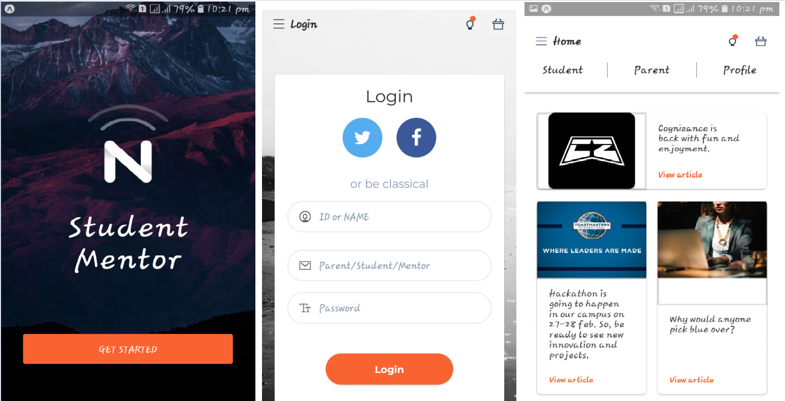
screenshots
.

Slide 7
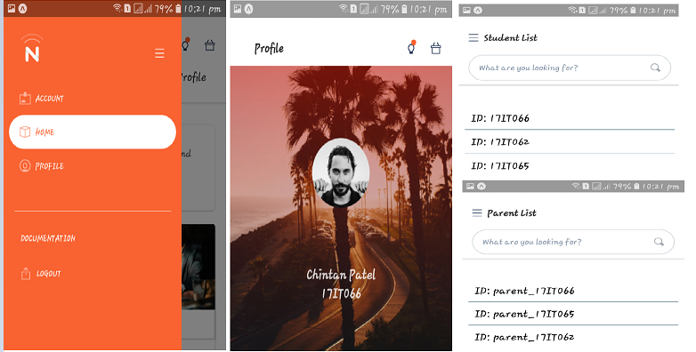
screenshots

Slide 8
References
https://github.com/Chintanpatel-student/Student-mentoring-app
https://reactnative.dev/docs/getting-started

Slide 9
Thank you

